Slide 1

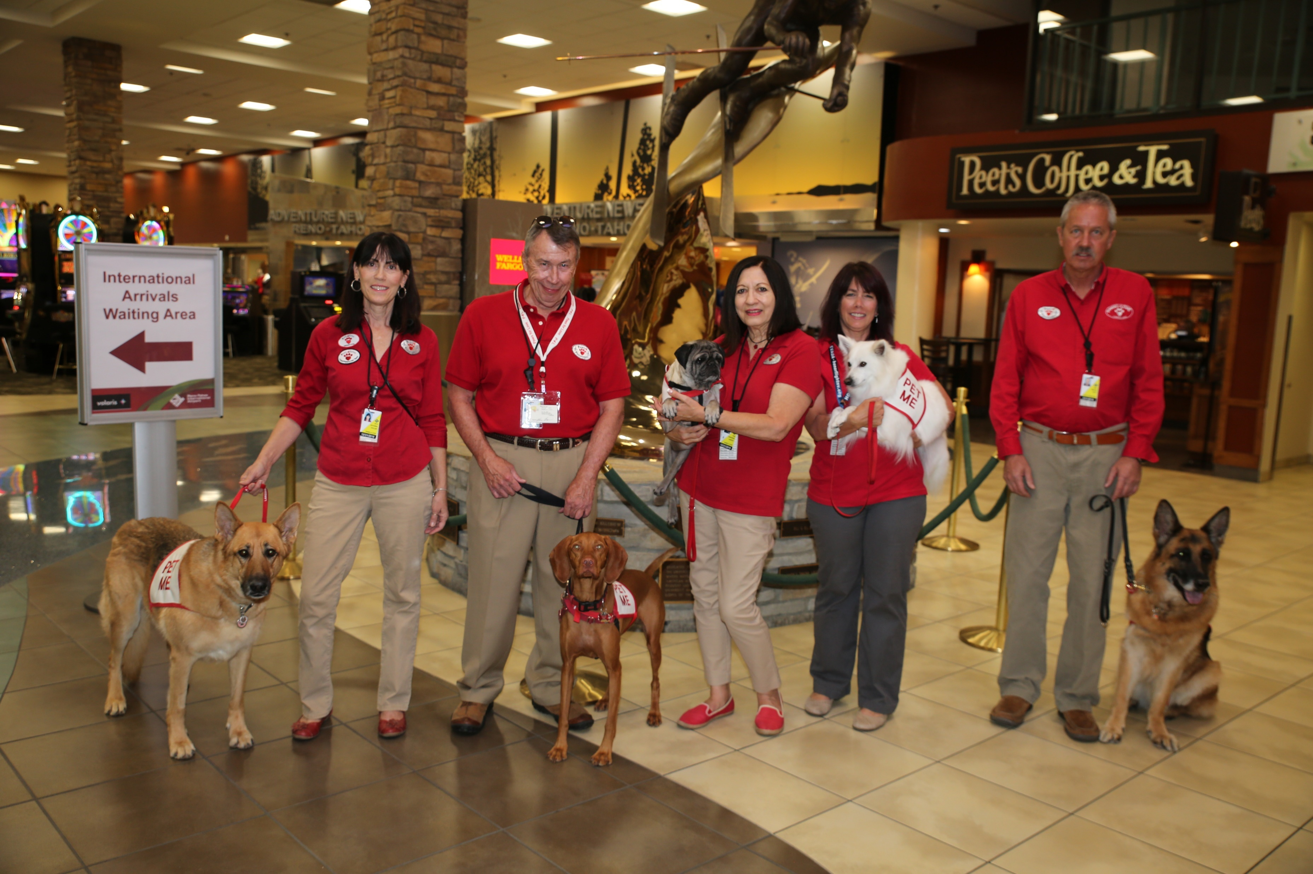
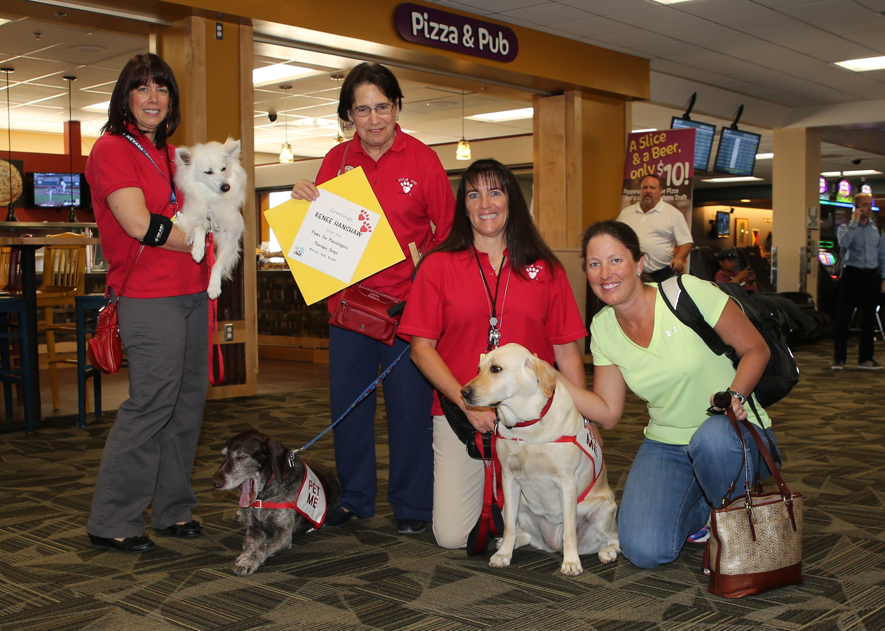

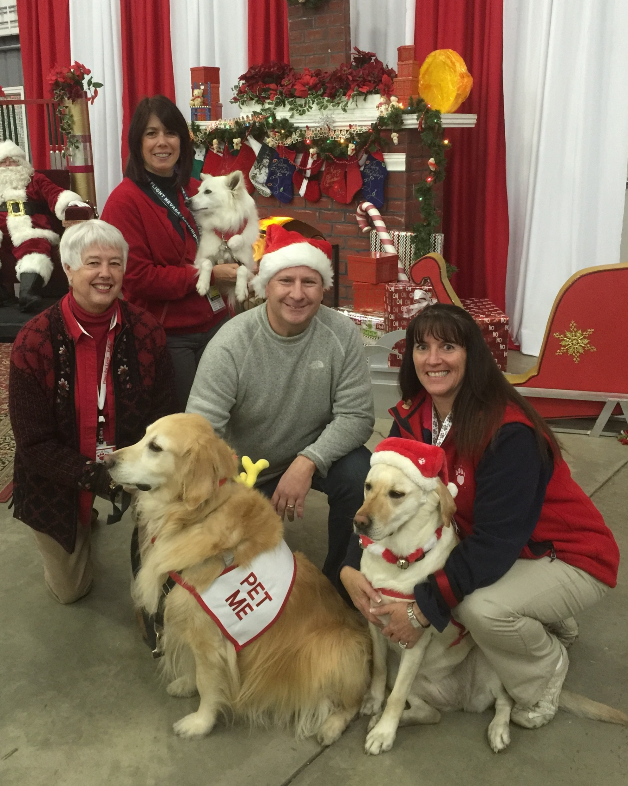
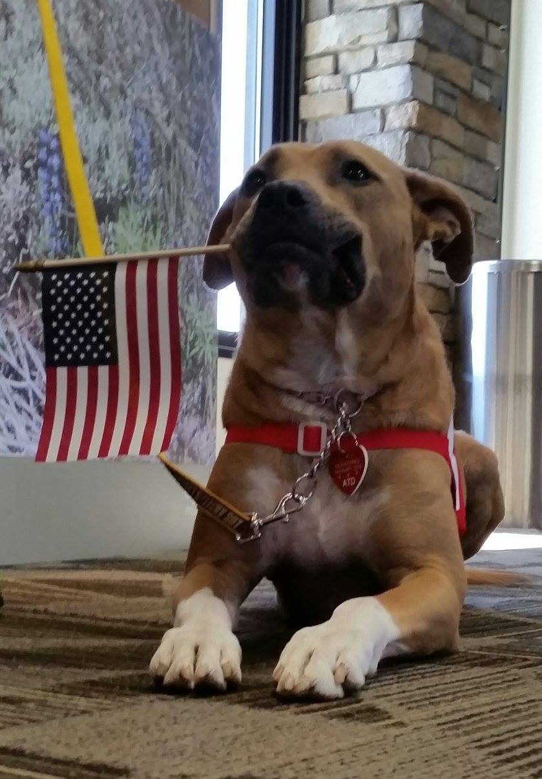
Paws 4 Passengers
Paws 4 Passengers is celebrating our 3rd Birthday with Dinner! Please join us in the FUN!
Wednesday, November 2, 2016 * Doors open at 5:30 PM
The Grove, 95 Foothill Road, Reno, NV 89511
Business Casual / Live Music / Fabulous Raffle Prizes and Silent Auction Items………you could go home with 2 round trip tickets on Southwest Airlines!
Paws 4 Passengers is a 501c3 Nevada Corporation so your donations are Tax Deductible.
Tickets: $70 per person or $500 per table (8) – a savings of $60!!!
Purchase your tickets NOW!!! The deadline to purchase your tickets is October 15, 2016.
E-mail us at info@paws4passengers.org or visit our Facebook page (Paws4Passengers).
Vegetarian Plate available upon request.
Yes, there will be “PET ME” dogs for you to enjoy before dinner! If you are allergic, or have a fear of dogs, please let us know and we’ll keep our distance.
GET YOUR TICKETS NOW!
We will be selling them at both locations of Scraps Dog Company on 10-1-16 from 11AM-4PM! (7675 S. Virginia St., #A and 1654 Robb Dr., #K1). See you there!

